Slide 1



Coronavirus Pandemic (COVID-19) Dashboard
Project 3
Hannah Hill – Sahar Jamal – Neda Mehdizadeh
Notes:
It is known that infection with SARS-CoV-2, the virus that causes COVID-19, can result in a range of illnesses, from mild symptoms to severe illness and death. About 30% of persons infected with SARS-CoV-2 do not have symptoms.

Slide 2



COVID-19 and Vaccine Basics
The combination of getting vaccinated and following CDC recommendations to protect yourself and others offers the best protection from COVID-19.
Cover your nose and mouth with a mask.
Stay at least 6 feet from people who don’t live with you.
Avoid crowds and poorly ventilated indoor spaces.
Wash your hands.
Getting vaccinated can help prevent getting sick with COVID-19
Getting vaccinated can help prevent getting sick with COVID-19
COVID-19 vaccines will not cause you to test positive on COVID-19 viral tests

Slide 3
COVID-19 and Vaccine Data Dashboard
In this dashboard we present trends for the 2020-2021 data regarding COVID-19:
Get an overview of the pandemic for any country on a single page
Explore the global datasets on covid vaccination
Explore the data confirmed Covid-19 cases for all countries
Explore metrics like total life expectancy, total hospital beds and human development index in each country
Our dashboard would be useful for travelers or those interested in researching the COVID-19 pandemic and its trends.

Slide 4

Data Source
We obtained Data as a csv file from : https://ourworldindata.org/coronavirus
and https://github.com/owid/covid-19-data/tree/master/public/data

Slide 5
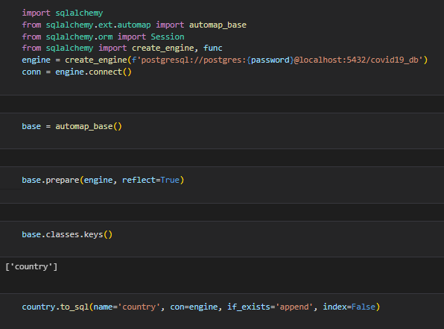
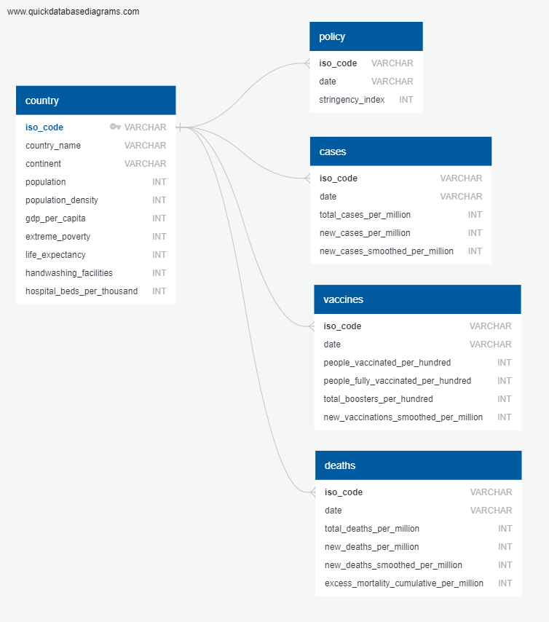
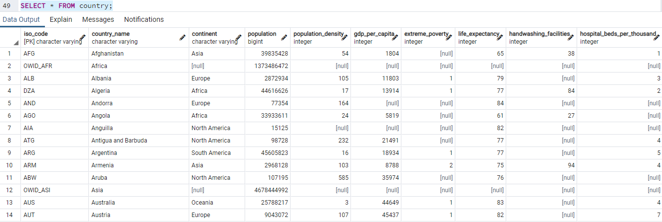
Design and Build Database

Slide 6
Data Wrangling
For Single Time Point Data:
Steps:
Load Data on Jupiter notebook
Cleaned the data and created the data frames with the most recent data
max_date = df.groupby('country_name')['date'].max()
Created json files for the Data :
df1.to_json('./export.json', orient='records')
For Time Dependent Data:
Steps:
Load Data on Jupiter notebook
Selected columns of interest
Created json files for the Data :
df1.to_json('./export.json', orient='records')

Slide 7


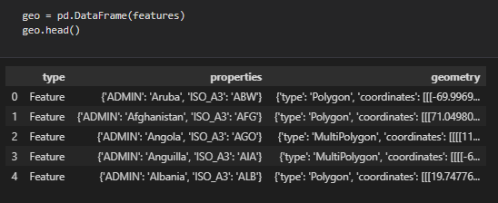
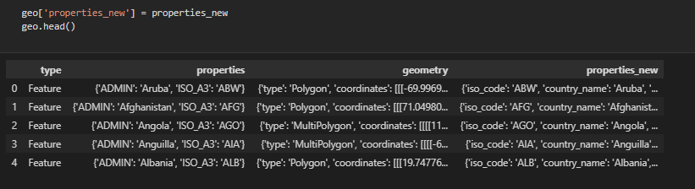
Update GeoJSON with Properties from Data
Get basic country GeoJSON from
https://datahub.io/core/geo-countries
Modify properties with
COVID-19 data

Slide 8
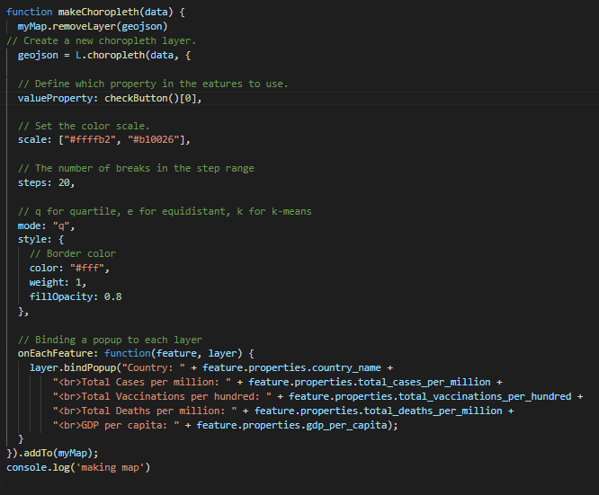
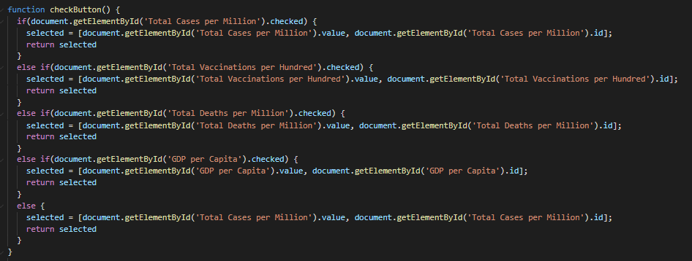
Build Interactive Choropleth Map

Slide 9
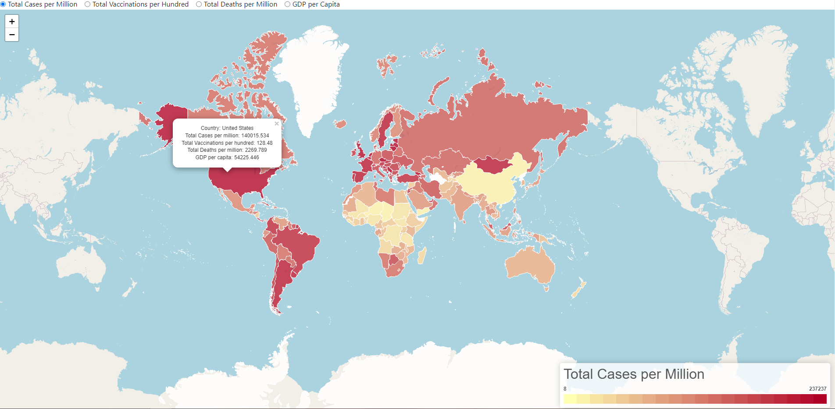
A choropleth map – Total Cases per million

Slide 10
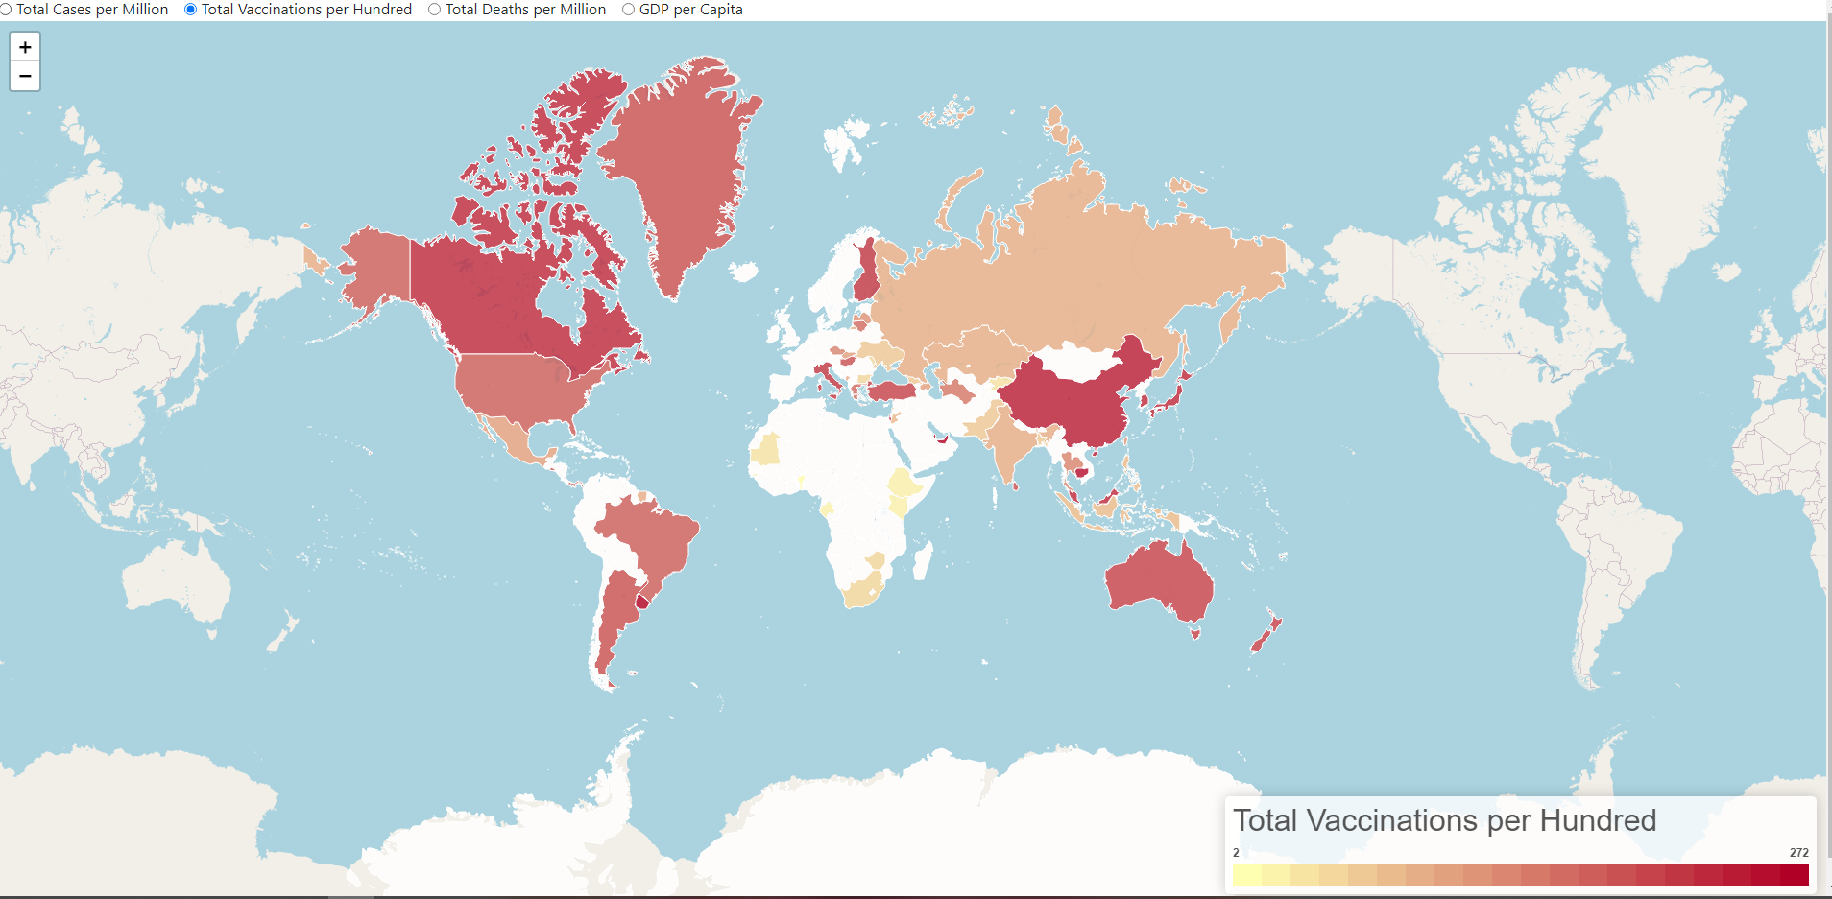
A choropleth map – Total vaccination per hundred

Slide 11
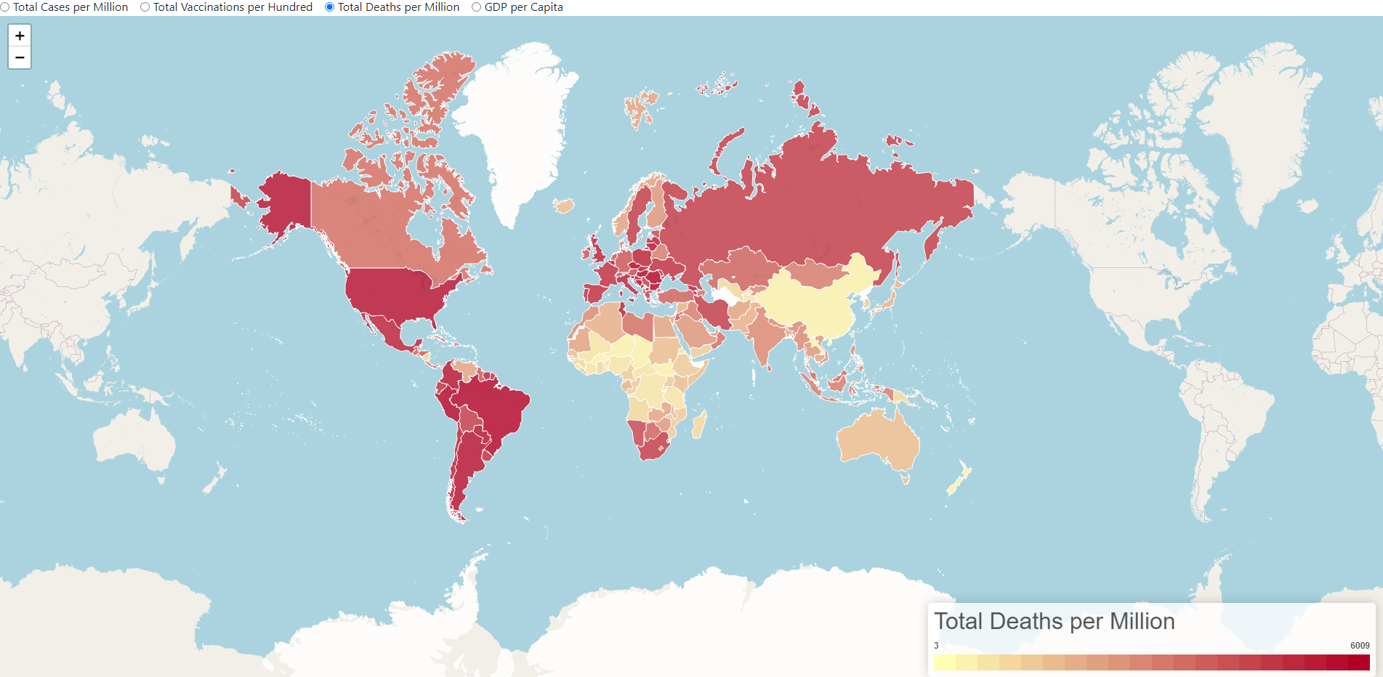
A choropleth map – Total Deaths per Million

Slide 12
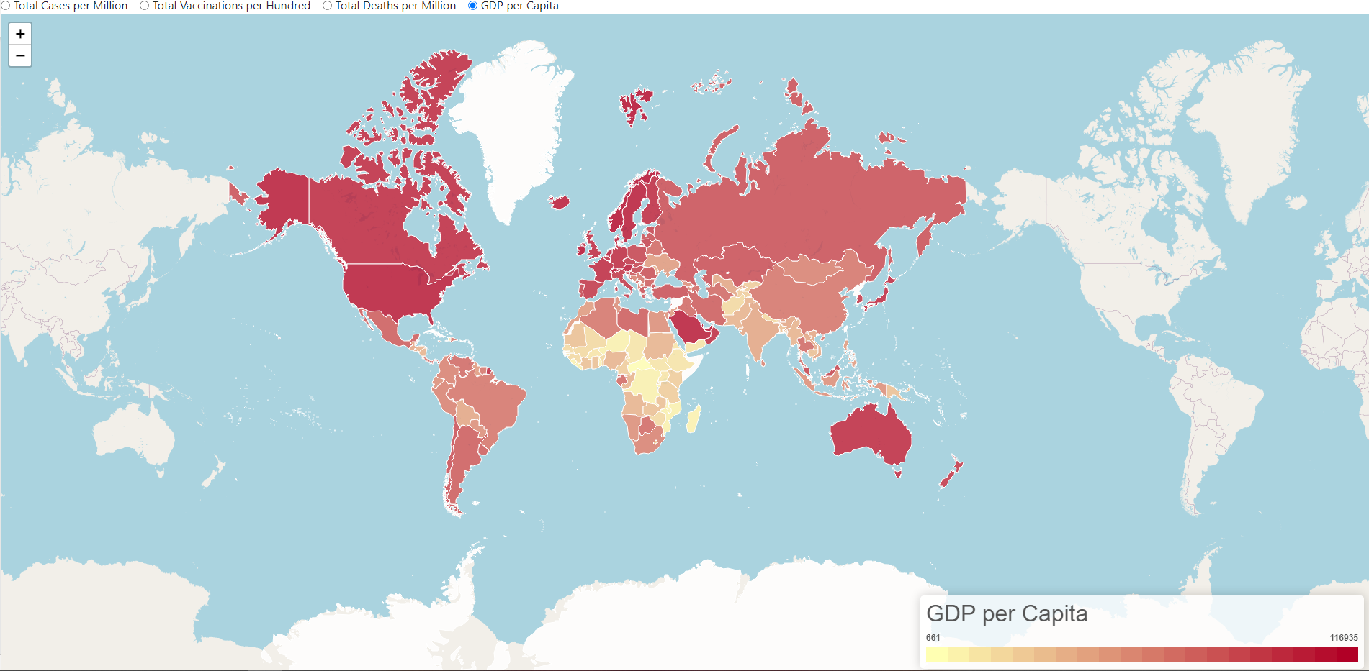
A choropleth map – GDP per Capita

Slide 13
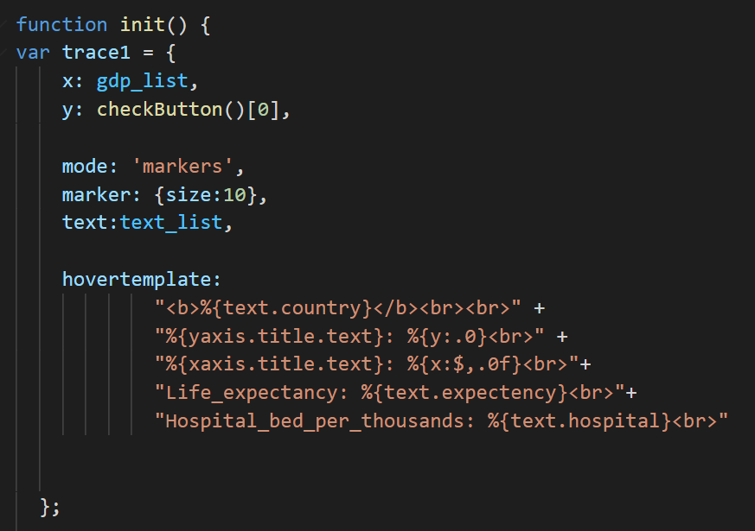
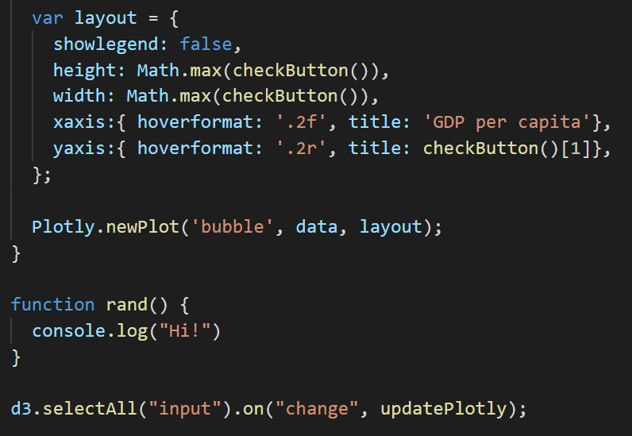
Interactive Scatter Plot - Code

Slide 14
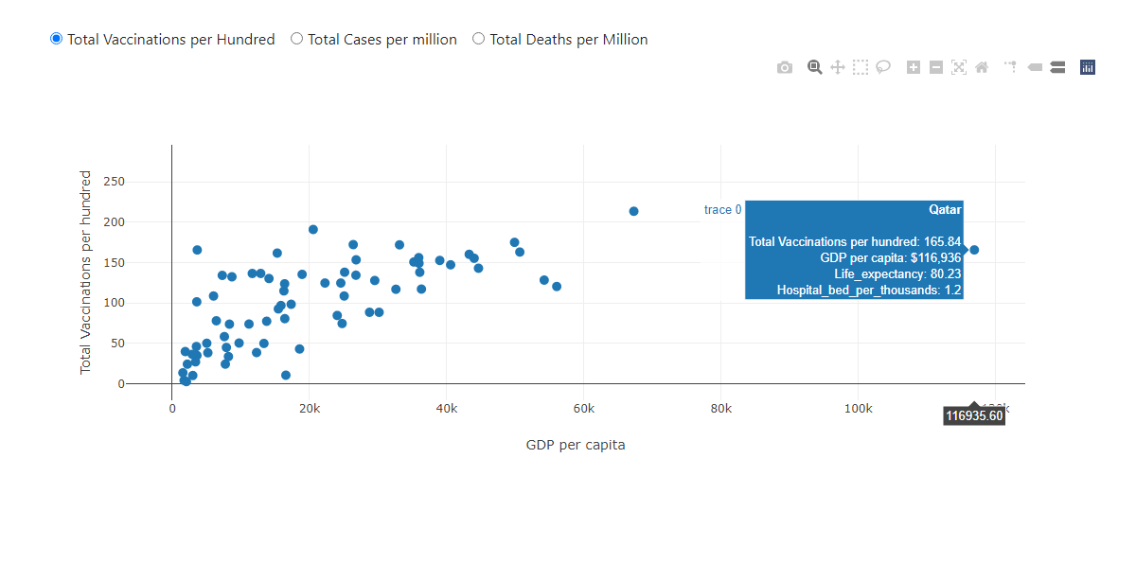
Interactive Scatter Plot - Total Vaccination
Countries with higher GDP have the higher number of total vaccination/100

Slide 15
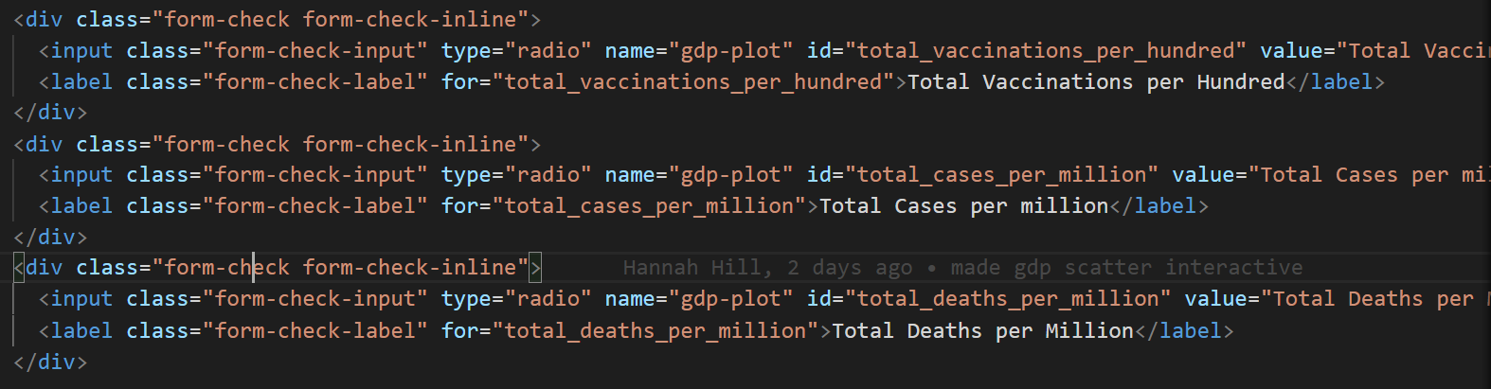
Interactive Scatter Plot - Radio Button

Slide 16
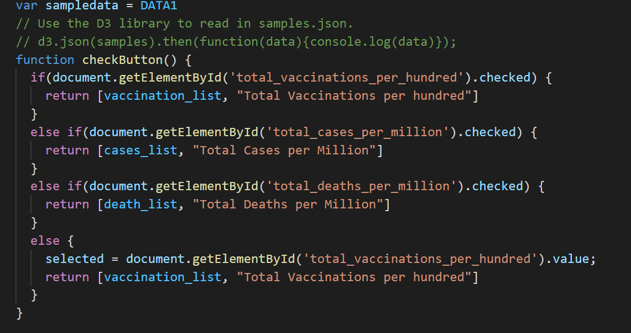
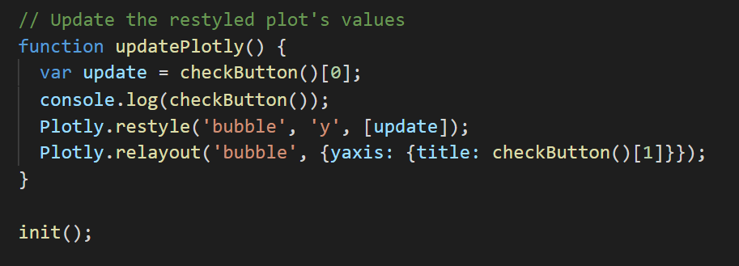

Slide 17
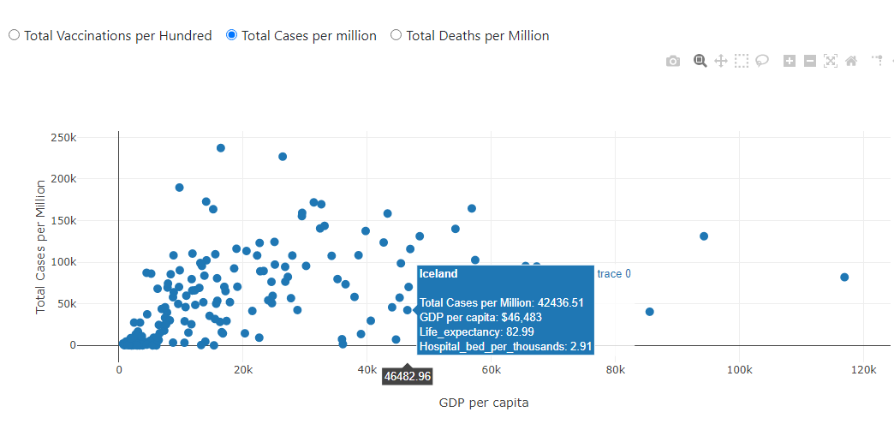
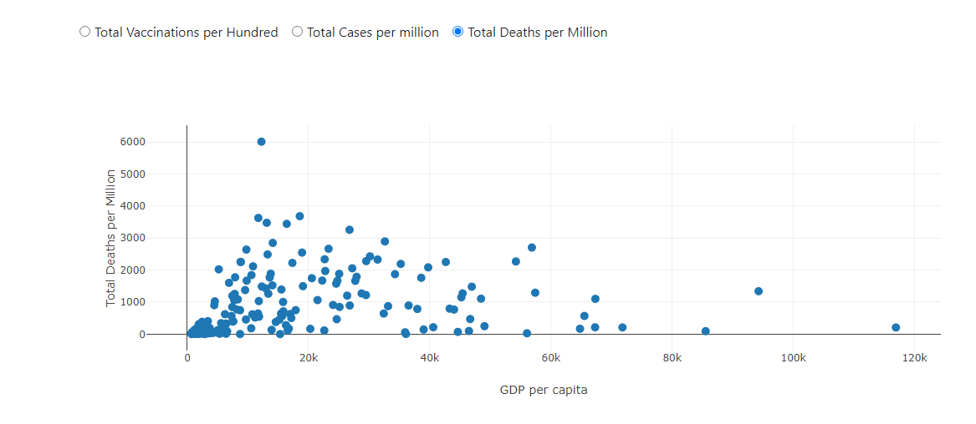
Interactive Scatter Plot- Total Cases per million & total deaths
Countries with lower GDPs have the higher total cases and total deaths

Slide 18
Sahar’s plots …………….
Sahar tell your story her ☺

Slide 19


